Slide 1
Introduction to Programming using Python

Slide 2
Setting Expectations
Target Audience
People new to programming
Students
Career changers
IT Pros
Anyone with an interest in learning to code
If you want to follow along...
Install Visual Studio Express
Install the Python tools
Instructions coming soon...

Slide 3
Getting started
Why and How

Slide 4
Why Python?
There are a LOT of different programming languages out there
Python is one of the easier ones to learn
There are lots of free tools out there you can use to code or learn Python
There are a lot of different ways to use Python code

Slide 5
Python Overview
Python is a high-level, interpreted, interactive and object oriented-scripting language.
Python was designed to be highly readable which uses English keywords frequently where as other languages use punctuation and it has fewer syntactical constructions than other languages.
Python is Interpreted: This means that it is processed at runtime by the interpreter and you do not need to compile your program before executing it. This is similar to PERL and PHP.
Python is Interactive: This means that you can actually sit at a Python prompt and interact with the interpreter directly to write your programs.
Python is Object-Oriented: This means that Python supports Object-Oriented style or technique of programming that encapsulates code within objects.
Python is Beginner's Language: Python is a great language for the beginner programmers and supports the development of a wide range of applications, from simple text processing to WWW browsers to games.

Slide 6
What is a Software Program?
Software Program
A software program is commonly defined as a set of instructions, or a set of modules or procedures, that allow for a certain type of computer operation.
sequential flow
A program is a sequence of instructions (called programming statements), executing one after another in a predictable manner.
Sequential flow is the most common and straight-forward, where programming statements are executed in the order that they are written - from top to bottom in a sequential manner, as illustrated in the following flow chart.
The following program prints the area and circumference of a circle, given its radius.
Take note that the programming statements are executed sequentially - one after another in the order that they were written.

Slide 7
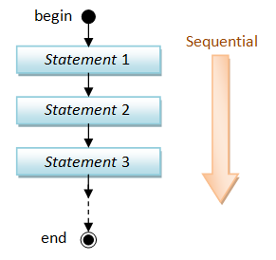
Sequential Execution

Slide 8
What is Programming Language?
A programming language is a vocabulary and set of grammatical rules for instructing a computer or computing device to perform specific tasks.
The term programming language usually refers to high-level languages, such as Ada, BASIC, C, C++, C#, COBOL, Java, FORTRAN, Groovy, LISP, Pascal, PHP, Python, Ruby, Scala, SmallTalk etc.
Each programming language has a unique set of keywords (words that it understands) and a special syntax for organizing program instructions.

Slide 9
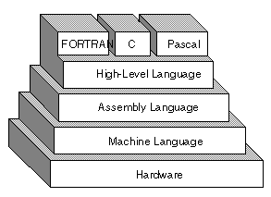
What is Programming Language?

Slide 10
What is Assembley Language?
An assembly language is a low-level programming language for microprocessors and other programmable devices. It is not just a single language, but rather a group of languages.
An assembly language implements a symbolic representation of the machine code needed to program for a given CPU architecture.
Assembly language is also known as assembly code. The term is often also used synonymously with 2GL.
An assembly language is the most basic programming language available for any processor.
With assembly language, a programmer works only with operations that are implemented directly on the physical CPU.
Assembly languages generally lack high-level conveniences such as variables and functions, and they are not portable between various families of processors.
They have the same structures and set of commands as machine language, but allow a programmer to use names instead of numbers.
This language is still useful for programmers when speed is necessary or when they need to carry out an operation that is not possible in high-level languages.

Slide 11
What is Machine Language?
Machine language is the lowest-level programming language (except for computers that utilize programmable microcode).
Machine languages are the only languages understood by computers.
Why Humans Don't Use Machine Language?
While easily understood by computers, machine languages are almost impossible for humans to use because they consist entirely of numbers.
Programmers, therefore, use either a high-level programming language or an assembly language.
An assembly language contains the same instructions as a machine language, but the instructions and variables have names instead of being just numbers
Programs written in high-level languages are translated into assembly language or machine language by a compiler.
Assembly language programs are translated into machine language by a program called an assembler.
Every CPU has its own unique machine language. Programs must be rewritten or recompiled, therefore, to run on different types of computers.

Slide 12
What is High Level Language?
A high-level language is a programming language designed to simplify computer programming.
It is "high-level" since it’s several steps removed from the actual code run on a computer's processor.
High-level source code contains easy-to-read syntax that is later converted into a low-level language, which can be recognized and run by a specific CPU.
Most common programming languages are considered high-level languages.
C++, C#, Cobol, Fortran, Java, JavaScript, Lisp, Objective C,
Pascal, Perl, PHP, Python, Scala, Swift etc.
Each of these languages use different syntax. Some are designed for writing desktop software programs, while others are best-suited for web development. But they all are considered high-level since they must be processed by a compiler or interpreter before the code is executed.
Source code written in languages like C++ and C# must be compiled into machine code in order to run.
The compilation process converts the human-readble syntax of the high-level language into low-level code for a specific processor.
Source code written in scripting languages like Perl and PHP can be run through an interpreter, which converts the high-level code into a low-level language on-the-fly.

Slide 13
What is a Compiler?
A compiler is a software program that transforms high-level source code that is written by a developer in a high-level programming language into a low level object code (binary code) in machine language, which can be understood by the processor.
The process of converting high-level programming into machine language is known as compilation.
The processor executes object code, which indicates when binary high and low signals are required in the arithmetic logic unit of the processor.
A compiler that converts machine language into high-level natural language is called a de-compiler.
Compilers that produce the object code meant to run on a system are called cross-compilers.

Slide 14
What is a Interpreter?
An interpreter is a computer program that is used to directly execute program instructions written using one of the many high-level programming languages.
The interpreter transforms the high-level program into an intermediate language that it then executes, or it could parse the high-level source code and then performs the commands directly, which is done line by line or statement by statement.

Slide 15
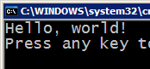



Compiling and interpreting
Many languages require you to compile (translate) your program into a form that the machine understands.
Python is instead directly interpreted into machine instructions.
compile
execute
source code
Hello.java
byte code
Hello.class
output
interpret
source code
Hello.py
output

Slide 16
History of Python:
Python was developed by Guido van Rossum in the late eighties and early nineties at the National Research Institute for Mathematics and Computer Science in the Netherlands.
Python is derived from many other languages, including ABC, Modula-3, C, C++, Algol-68, SmallTalk, and Unix shell and other scripting languages.
Python is copyrighted, Like Perl, Python source code is now available under the GNU General Public License (GPL).
Python is now maintained by a core development team at the institute, although Guido van Rossum still holds a vital role in directing it's progress.

Slide 17
Python Features
Easy-to-learn: Python has relatively few keywords, simple structure, and a clearly defined syntax.
Easy-to-read: Python code is much more clearly defined and visible to the eyes.
Easy-to-maintain: Python's success is that its source code is fairly easy-to-maintain.
A broad standard library: One of Python's greatest strengths is the bulk of the library is very portable and cross-platform compatible on UNIX, Windows, and Macintosh.
Interactive Mode: Support for an interactive mode in which you can enter results from a terminal right to the language, allowing interactive testing and debugging of snippets of code.

Slide 18
Python Features (cont’d)
Portable: Python can run on a wide variety of hardware platforms and has the same interface on all platforms.
Extendable: You can add low-level modules to the Python interpreter. These modules enable programmers to add to or customize their tools to be more efficient.
Databases: Python provides interfaces to all major commercial databases.
GUI Programming: Python supports GUI applications that can be created and ported to many system calls, libraries, and windows systems, such as Windows MFC, Macintosh, and the X Window system of Unix.
Scalable: Python provides a better structure and support for large programs than shell scripting.

Slide 19
Python Environment
Unix (Solaris, Linux, FreeBSD, AIX, HP/UX, SunOS, IRIX etc.)
Windows
Apple Max
OS/2
DOS (multiple versions)
PalmOS
Nokia mobile phones
Windows CE
VMS/OpenVMS
Python has also been ported to the Java and .NET virtual machines.

Slide 20
And as a bonus
Once you learn how to code in one programming language it will be easier to learn another programming language, and another, and another…
JavaScript
???
C#
C++
Perl

Slide 21
But let’s be clear about something…
You won’t learn enough in this course to start adding special effects to the next big superhero movie
You WILL learn enough to start solving real world problems with code
OR to just start having some fun ☺

Slide 22
So how do I get started?

Slide 23
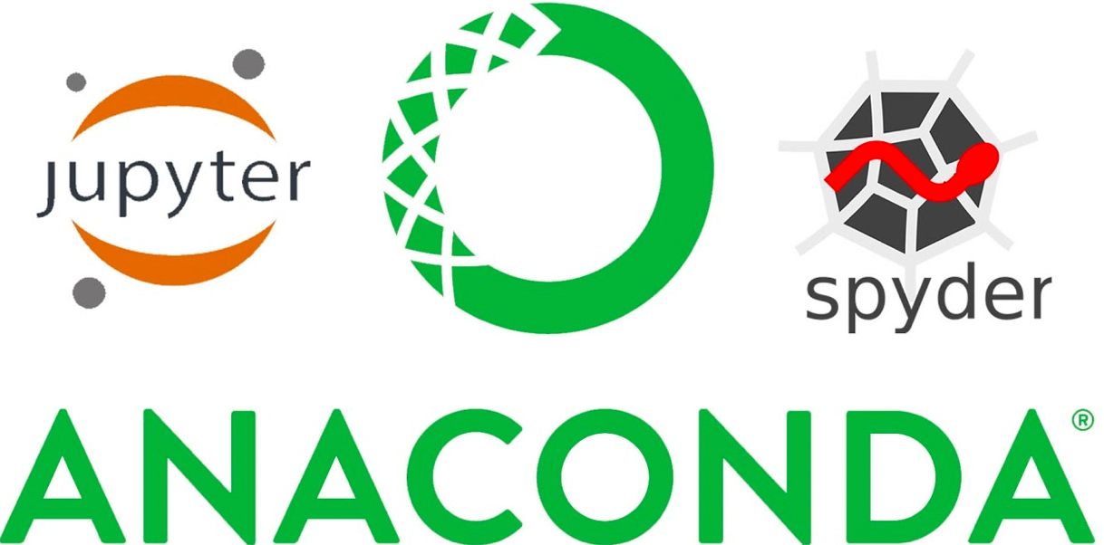
You need to install software on your PC/laptop
There are a lot of different tools out there you can use to write Python Code.
In this course we will use Anaconda Spyder + Jupyter notebook + VSCode
http://www.cdt-pv.org/media/resources/Anaconda-Quickstart.pdf

Slide 24
Anaconda Configuration
#Update conda
conda update conda
#Update Jupyter
conda update jupyter
#Anaconda help
conda –h
#install packages
conda install numpy
conda install pandas
conda install statsmodels
conda install matplotlib
conda install seaborn
#List installed packages
conda list
#install non conda packages
pip install <package>
#To Open Jupyter notebook from Anaconda Prompt, type
jupyter notebook
#To Open Spyder from Anaconda Prompt, type
start spyder
# Jupyter notebook can run R Codes also
conda install -c r r-essentials
To create an environment with a python version:
conda create -n myenv python=3.7
Create the environment from the environment.yml file:
conda env create -f environment.yml
You can make an exact copy of an environment by creating a clone of it:
conda create --name myclone --clone myenv
To verify that the copy was made:
conda info --envs

Slide 25
Geek Tip!
There are actually a lot of different version flavors of Python:
Python 2.x and 3.x
IronPython, IPython, CPython, PyPy, Jython, Canopy, Anaconda, …
We will be using the Anaconda interpreter with Python 3.7
So, if you copy code from a website and it doesn’t work don’t panic! It might just be a slightly different version of Python

Slide 26
How do I know I installed everything correctly?
There is a tradition among programmers
We always test our installation by writing the same program:
Hello World!

Slide 27
Creating your Hello World program!

Slide 28
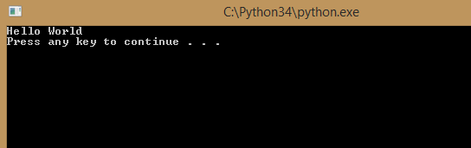
You have now created your first application
print('Hello World')

Slide 29
Best practices

Slide 30
Pick up good habits right away!
Comments in your code help you or someone else understand
What your program does
What a particular line or section of code does
Why you chose to do something a particular way
Anything that might be helpful to know if I am looking at the code later and trying to understand it!

Slide 31
In Python we use a # to indicate comments
#My first Python Application
#Created by me!
#Print command displays a message on the screen
print('Hello World')

Slide 32

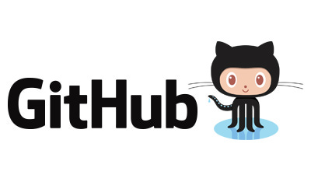
Git & GitHub

Slide 33
What is Git and GitHub
Git
version control system
SVN,StarTeam
Github
repository site, there are others such as bitbucket and visual Studio online

Slide 34
Git Config
https://git-scm.com/book/en/v2/Getting-Started-Installing-Git
Let’s define ourselves first
git config --global user.email "you@example.com"
git config --global user.name "Your Name"

Slide 35
Local first
first lets make a git folder in our computer
git init
add a file to the folder
git add newfile.file
git commit -m “new file added” newfile.file
If you don’t provide file after the comment, everything you have done will be committed.

Slide 36
Ignore?
Create a file called .gitignore
Write the file names that should be ignored by git
Commit the file

Slide 37
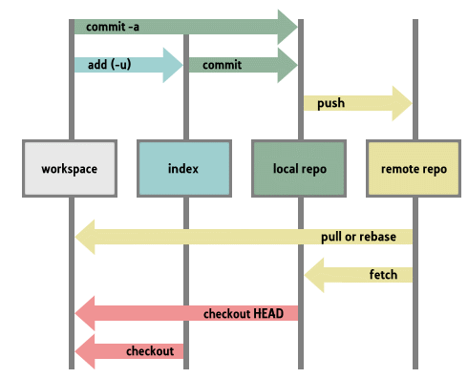
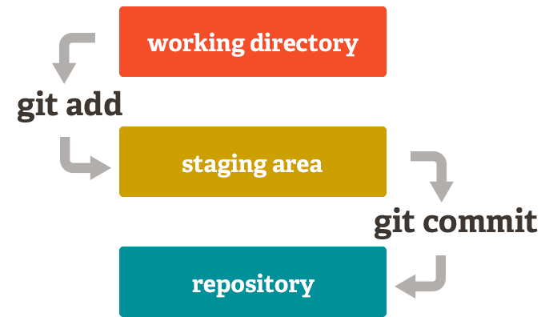
Git Indexing

Slide 38
Pulling a repository/editing
lets pull a repository from github
git pull https://github.com/ajith-kl2018/python-apr20
git remote add origin https://github.com/ajith-kl2018/python-apr20
defined the link as origin. No need to write this link every time
For Cloning an existing remote repo
git clone https://github.com/ajith-kl2018/python-apr20.git
Edit the file a.txt
git commit –am ‘something added’
git push origin

Slide 39
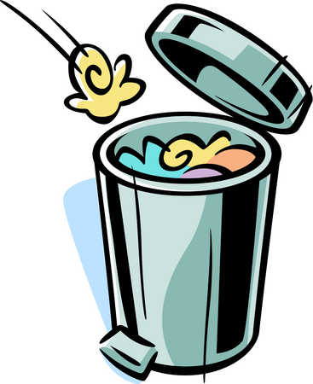
Remove a file
git rm somefile.txt
git commit –m ‘removed’
git push origin

Slide 40
Conflict
git commit -am 'Conflicts resolved‘

Slide 41
Go back to older version
Git log
Show me the logs git☺
See the commit id
git reset --hard c1ac571d9af5fe1126ecdf64c57d6ef4a5990a60 && git clean -f
Destroys the local modifications!
Removes untracked files!

Slide 42
One step back!
An easy way to revert last commit (1)
git revert HEAD~1..HEAD
git push origin

Slide 43
Displaying text
print

Slide 44
Many computer programs provide information
One of the simplest but important things you need the ability to do in your code is display text

Slide 45
The print statement is used to display text
print('Hickory Dickory Dock! The mouse ran up the clock')
print("Hickory Dickory Dock! The mouse ran up the clock")
You can use single quotes or double quotes

Slide 46
Printing text

Slide 47
Multiple lines

Slide 48
Does it matter if you use single or double quotes?
print("It's a beautiful day in the neighborhood")
print('It's a beautiful day in the neighborhood')
Only if the string you are displaying contains a single or double quote.
It’s a good habit to pick one and stick with it as much as possible.

Slide 49
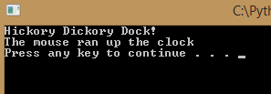
What if I want my text to appear on multiple lines?
You can use multiple print statements
print('Hickory Dickory Dock!')
print('The mouse ran up the clock')

Slide 50
You can also use “\n” to force a new line
print('Hickory Dickory Dock!\nThe mouse ran up the clock')

Slide 51
Here’s a neat Python trick: triple quotes!
print("""Hickory Dickory Dock!
The mouse ran up the clock""")
print('''Hickory Dickory Dock!
The mouse ran up the clock''')
When you put the string in triple quotes, it will be displayed the way you have the string in the text editor

Slide 52
Line Management

Slide 53
Same problem, multiple solutions

Slide 54
Which do you think is better?
print('Hickory Dickory Dock!')
print('The mouse ran up the clock')
print('Hickory Dickory Dock!\nThe mouse ran up the clock')
print('''Hickory Dickory Dock!
The mouse ran up the clock''')

Slide 55
Geek Tips
There is often more than one way to solve the same problem
Sometimes it really doesn’t matter which way you do it, as long as it works!

Slide 56
Multiple options, same output

Slide 57
When good code goes bad...

Slide 58
There is another important programming concept you need to learn as well
It’s okay to make mistakes in your code
All programmers make typing mistakes and coding mistakes

Slide 59
So it might be useful to practice finding our mistakes
print(Hickory Dickory Dock)
print('It's a small world')
print("Hi there')
prnit("Hello World!")
print('Hickory Dickory Dock')
print("It's a small world")
print("Hi there")
print("Hello World!")

Slide 60
Your challenge should you choose to accept it
Write a program that will display the following poem on the screen
There once was a movie star icon
who preferred to sleep with the light on.
They learned how to code
a device that sure glowed
and lit up the night using Python!

Slide 61
String variables and asking a user to enter a value
input

Slide 62
How can we ask a user for information?
name = input("What is your name? ")
The input function allows you to specify a message to display and returns the value typed in by the user.
We use a variable to remember the value entered by the user.
We called our variable “name” but you can call it just about anything as long the variable name doesn’t contain spaces

Slide 63
Think of a variable as a box where you can store something and come back to get it later.
name
Chris

Slide 64
If you need to remember more than one value, just create more variables
favoriteMovie
name
Chris
Real Genius
city
Pasadena

Slide 65

You can access the value you stored later in your code
name = input("What is your name?
print(name)
"

Slide 66
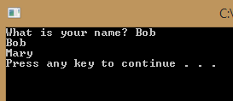
You can also change the value of a variable later in the code
name = input("What is your name?
print(name)
name = "Mary"
print(name)

Slide 67
Which of the following do you think would be good names for variables?
Variable1
First Name
Date
3Name
DOB
DateOfBirth
YourFavoriteSignInTheHoroscope

Slide 68
Variable names
Should be meaningful (e.g. FirstName not variable1)
Should be specific (BirthDate not Date)
Should not contain spaces (FirstName not First Name)
Should be descriptive but not too long (FavoriteSign not YourFavoriteSignInTheHoroscope)
Are case sensitive (FirstName and firstname would be two different variables)
Cannot start with a number (Name1 is okay 1Name is not)

Slide 69
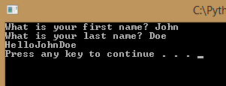
You can combine variables and strings with the + symbol
firstName = input("What is your first name? ")
lastName = input("What is your last name? " )
print("Hello" + firstName + lastName)

Slide 70
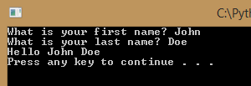
Often you need to add punctuation or spaces to format the output correctly
firstName = input("What is your first name? ")
lastName = input("What is your last name? " )
print("Hello " + firstName + " " + lastName)

Slide 71
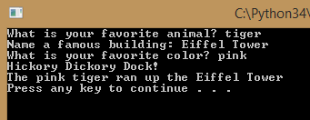
Now you can create a story teller program!
animal = input("What is your favorite animal? " )
building = input("Name a famous building: ")
color = input("What is your favorite color? ")
print("Hickory Dickory Dock!")
print("The "+color+" "+animal+" ran up the "+building)

Slide 72
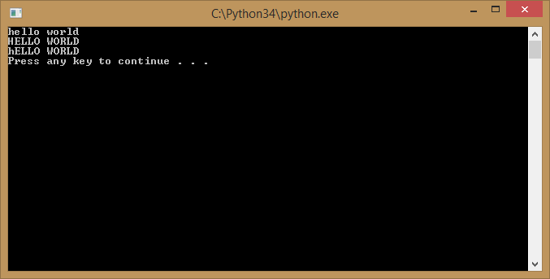
Variables also allow you to manipulate the contents of the variable
message = 'Hello world'
print(message.lower())
print(message.upper())
print(message.swapcase())

Slide 73
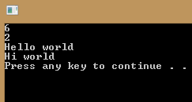
What do you think these functions will do?
message = 'Hello world'
print(message.find('world'))
print(message.count('o'))
print(message.capitalize())
print(message.replace('Hello','Hi'))

Slide 74
How could we…
Have a user enter their postal code and then display that postal code in all upper case letters even if the user typed it in lowercase?
postalCode = input("Please enter your postal code: ") print(postalCode.upper())

Slide 75
Did you notice?
The intellisense didn’t appear to help us select the upper() function.
That’s because our program didn’t know we were going to store a string value, in the postalCode variable. The upper() function is only for strings.
A good habit when coding in any language is to initialize your variables. That means when you create them you give them an initial value.
postalCode = " "
postalCode = input("Please enter your postal code: ")
print(postalCode.upper())

Slide 76
How could we…
Ask someone for their name and then display the name someone with the first letter of their first and last name uppercase and the rest of their name lowercase?
name = " "
name = input("Please enter your name: ")
print(name.capitalize())

Slide 77
Functions and variables allow us to make new mistakes in our code…
Each line of code below has a mistake…
message = Hello world
23message = 'Hello world'
New message = 'Hi there'
print(message.upper)
print(mesage.lower())
print(message.count())
message = 'Hello world'
23message = 'Hello world'
New message = 'Hi there'
print(message.upper())
print(message.lower())
print(message.count('H'))

Slide 78
Storing numbers

Slide 79
You can store numbers in variables as well
age = 42
print(age)

Slide 80
With numbers you can do math
width = 20
height = 5
area = width * height
print(area)
perimeter = 2*width + 2*height
print(perimeter)
perimeter = 2*(width+height)
print(perimeter)

Slide 81
Math rules haven’t changed since Grade 4
Order of operations
( ) parentheses
** exponent (e.g. **2 squared **3 cubed)
*/ multiplication and division
+ - addition and subtraction

Slide 82

Of course this means we have more ways to make mistakes too!
salary = '5000'
bonus = '500'
payCheck = salary + bonus
print(payCheck)
What did we do wrong?

Slide 83

Because we put quotes around the values, the program thought salary and bonus were strings so it concatenated instead of adding
salary = 5000
bonus = 500
payCheck = salary + bonus
print(payCheck)

Slide 84
Could you ask the user to enter their bonus and salary values?
salary = input("Please enter your salary: ")
bonus = input("Please enter your bonus: ")
payCheck = salary + bonus
print(payCheck)
What went wrong?

Slide 85
The input function always returns a string
We need a way to tell our program that it’s a number and not a string

Slide 86
There are functions to convert from one datatype to another.
int(value) converts to an integer
long(value) converts to a long integer
float(value) converts to a floating number (i.e. a number that can hold decimal places)
str(value) converts to a string
Which function should we use for our scenario?

Slide 87
Since the amounts entered could include decimals – choose float
salary = input("Please enter your salary: ")
bonus = input("Please enter your bonus: ")
payCheck = float(salary) + float(bonus)
print(payCheck)
What do you think will happen if someone types “BOB” as their salary
The code crashes because we can’t convert the string “BOB” into a numeric value. We will learn how to handle errors later!

Slide 88
Working with dates and times
datetime

Slide 89
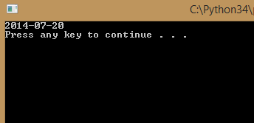
What is today’s date?
The datetime class allows us to get the current date and time
#The import statement gives us access to
#the functionality of the datetime class
import datetime
#today is a function that returns today's date
print (datetime.date.today())

Slide 90
You can store dates in variables
import datetime
#store the value in a variable called currentDate
currentDate = datetime.date.today()
print (currentDate)

Slide 91
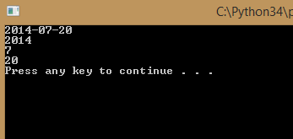
You can access different parts of the date
import datetime
currentDate = datetime.date.today()
print (currentDate)
print (currentDate.year)
print (currentDate.month)
print (currentDate.day)

Slide 92
But what if you want to display the date with a different format?
Welcome to one of the things that drives programmers insane!
Different countries and different users like different date formats, often the default isn’t what you need
There is always a way to handle it, but it will take a little time and extra code
The default format is YYYY-MM-DD

Slide 93
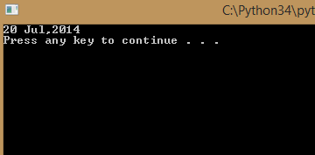
In Python we use strftime to format dates
import datetime
currentDate = datetime.date.today()
#strftime allows you to specify the date format
print (currentDate.strftime('%d %b,%Y'))

Slide 94
What the heck are %d %b and %Y?
%d is the day of the month
%b is the abbreviation for the current month
%Y is the 4 digit year

Slide 95
Here’s a few more you may find useful
%b is the month abbreviation
%B is the full month name
%y is two digit year
%a is the day of the week abbreviated
%A is the day of the week
For a full list visit strftime.org

Slide 96
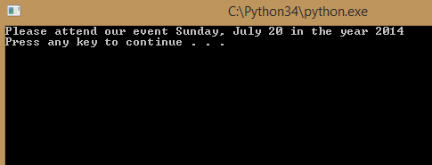
Could you print out a wedding invitation?
“Please attend our event Sunday, July 20th in the year 1997”
import datetime
currentDate = datetime.date.today()
#strftime allows you to specify the date format
print (currentDate.strftime
('Please attend our event %A, %B %d in the year %Y'))

Slide 97
So… what if I don’t want English?
In programmer speak we call that localization
Did I mention dates drive programmers insane?
By default the program uses the language of the machine where it is running
But… since if you can’t always rely on computer settings it is possible to force Python to use a particular language
It just takes more time and more code. You will probably want the babel Python library http://babel.pocoo.org/

Slide 98
Can I ask a user for their birthday?
birthday = input ("What is your birthday? ")
print ("Your birthday is " + birthday)
Can you think of any situations where this code might not work the way we want?

Slide 99
Can I ask a user for their birthday?
birthday = input ("What is your birthday? ")
print ("Your birthday is " + birthday)
What datatype is birthday?
string
if we want to treat it like a date (for example use the datetime functions to print it in a particular format) we must convert it to a date

Slide 100
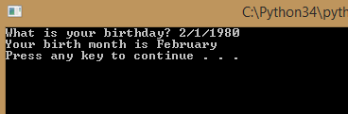
The strptime function allows you to convert a string to a date
import datetime
birthday = input ("What is your birthday? ")
birthdate =
datetime.datetime.strptime(birthday,"%m/%d/%Y").date()
#why did we list datetime twice?
#because we are calling the strptime function
#which is part of the datetime class
#which is in the datetime module
print ("Your birth month is " + birthdate.strftime('%B'))

Slide 101
But what if the user doesn’t enter the date in the format I specify in strptime?
birthdate = datetime.datetime.strptime(birthday,"%m/%d/%Y")
Your code will crash so…
Tell the user the date format you want
birthday = input ("What is your birthday? (mm/dd/yyyy) ")
Add error handling, which we will cover in a later module

Slide 102
Dates seem like a lot of hassle, is it worth it? Why not just store them as strings!
You can create a countdown to say how many days until a big event or holiday
nextBirthday =
datetime.datetime.strptime('12/20/2014','%m/%d/%Y').date()
currentDate = datetime.date.today()
#If you subtract two dates you get back the number of days
#between those dates
print (nextBirthday - currentDate)

Slide 103
Dates seem like a lot of hassle, is it worth it? Why not just store them as strings!
You can tell someone when the milk in their fridge will expire
currentDate = datetime.date.today()
#timedelta allows you to specify the time
#to add or subtract from a date
print (currentDate + datetime.timedelta(days=15))
print (currentDate + datetime.timedelta(hours=15))

Slide 104
You will be amazed how often you need to work with dates!
If datetime doesn’t have what you need, check out the dateutil library (for example you might want to know the number of years between two dates instead of number of days)

Slide 105
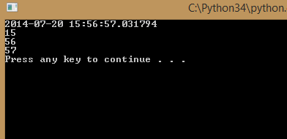
What about times?
It is called Datetime, so yes it can store times.
import datetime
currentTime = datetime.datetime.now()
print (currentTime)
print (currentTime.hour)
print (currentTime.minute)
print (currentTime.second)

Slide 106
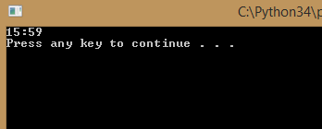
Just like with dates you can use strftime() to format the way a time is displayed
import datetime
currentTime = datetime.datetime.now()
print (datetime.datetime.strftime(currentTime,'%H:%M'))
%H Hours (24 hr clock)
%I Hours (12 hr clock)
%p AM or PM
%m Minutes
%S Seconds

